Slide 1
Grading System
CS 591 P1 Final Project
Professor Christine Papadakis Kanaris
TEAM MEMBERS | EMAIL IDs
Alimkhanov, Yernur | yernura@bu.edu
Gao, Tian | gaotian@bu.edu
Duan, Lian | lduan@bu.edu
Das, Yashvardhan | yashvdas@bu.edu

Slide 2
Contents
Introduction
UI/System design overview
Plans/progress

Slide 3
Introduction
A grading system
Satisfy Professor’s need to grade for students conveniently (different courses, different percentage over assignments/exams etc)
We asked about what Professor needs, and present here our design for the system
In addition our thoughts and plans on finishing the project

Slide 4
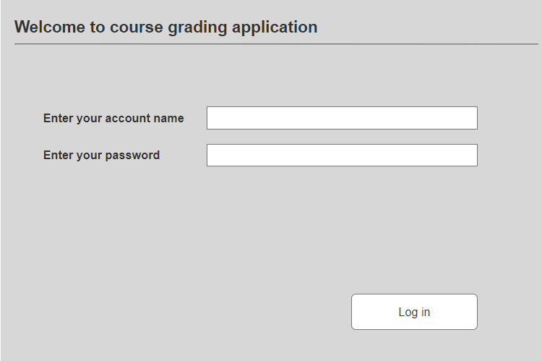
Log-in page
First page of the application
After user enter his credential course selection page will be opened

Slide 5
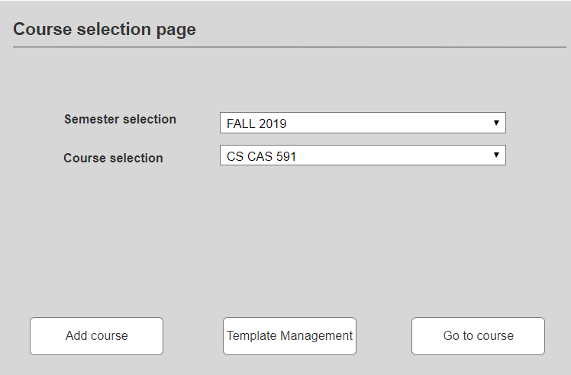
Course selection page
User should select semester and course, which she wants to manage.
This menu provides links to course addition and template management pages.

Slide 6
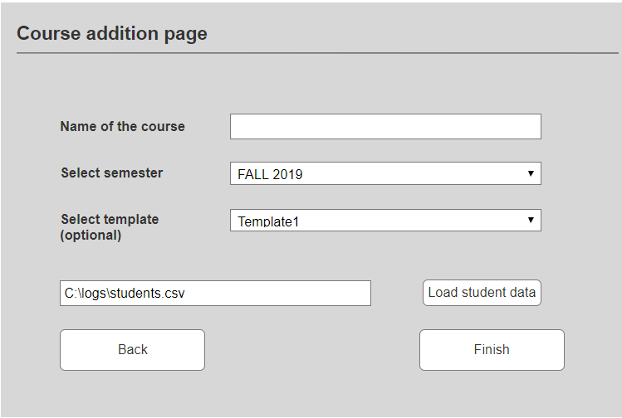
Add Course Page
Add course with current template
Load student data from CSV file (optional)

Slide 7
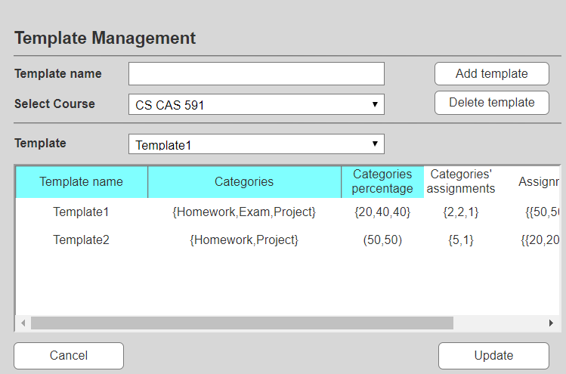
Template Management Page
Change the structure of template
Add or delete template

Slide 8
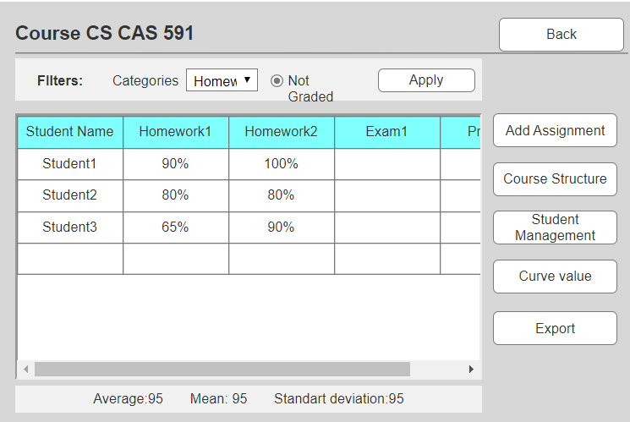
Main menu
Main page of application
Add grade of assignments
Filter assignments
Give course statistics

Slide 9
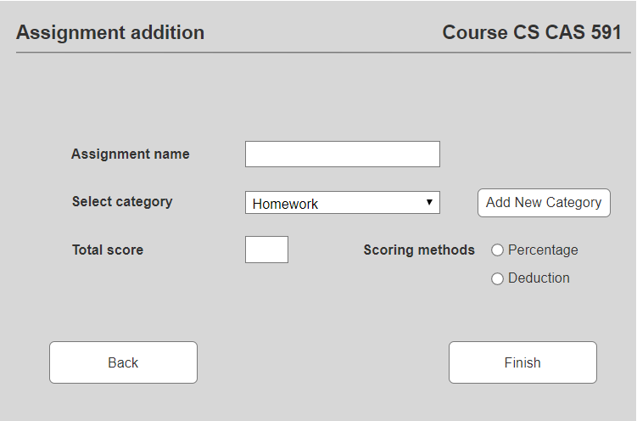
Assignment Addition page
Add assignments
Select category
Add category
Choose scoring methods
Choose total score

Slide 10
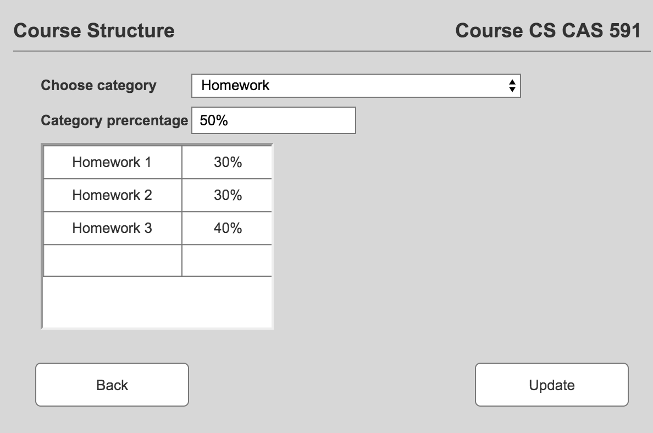
Course Structure Page
Change the percentage of each category (homework, exam, project, etc.)
Change the percentage of items in certain category

Slide 11
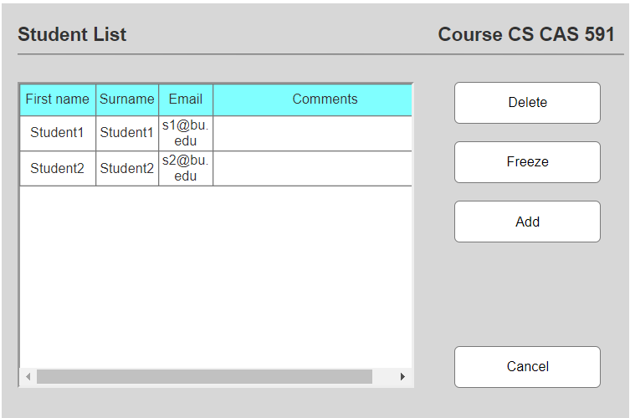
Student Management Page
Add, delete or freeze a student
Update information of student
Add some comments to student

Slide 12
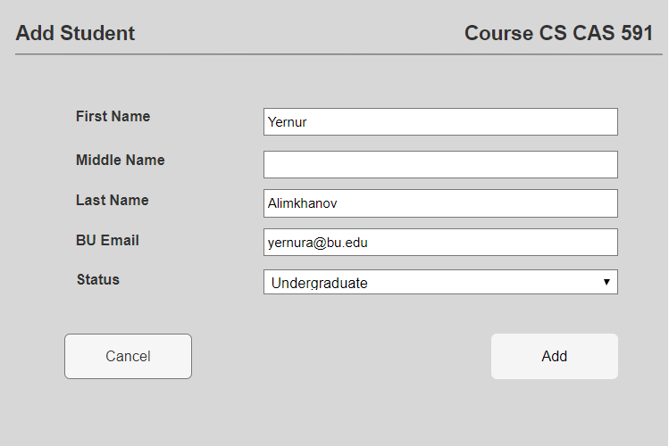
Student Addition Page
Input the information of a student then add the student to the class

Slide 13
Plans and progresses
Finished:
We discussed over the user cases and functionalities of the app
We drew UI design
We designed our first stage backend class diagrams
We designed our database structure
To do:
Finish building the backend classes
Finish building the database structure
Create UI pages
Modify details of the project

Slide 14
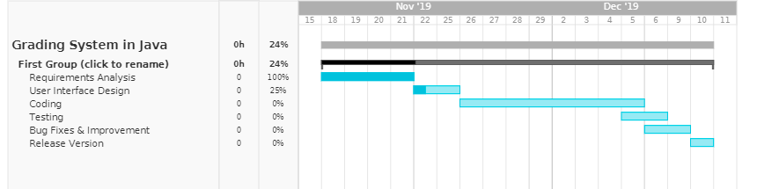
Gantt Chart

Slide 15
Mockup presentation

Slide 16

Questions

Slide 17
Thank you for attention!!!!

